Slide 1
Alternative Timing in Digital Logic
George Conover

Slide 2
Agenda
Current Design
Asynchronous Circuits
Pros and Cons
Design
Microprocessors
Elastic Circuits
GALS
Elastic Clocks
Simulations

Slide 3
Intel Processor Speeds

Slide 4
Current Methods
Increase Throughput:
Multi-core
Superscalar
Better-Than-Worst-Case
Decrease Power
Clock Gating
Mix Low/High Threshold Transistors
Reduced Pipeline
Automatic Voltage Scaling
Clock Throttling
Glitch Reduction

Slide 5
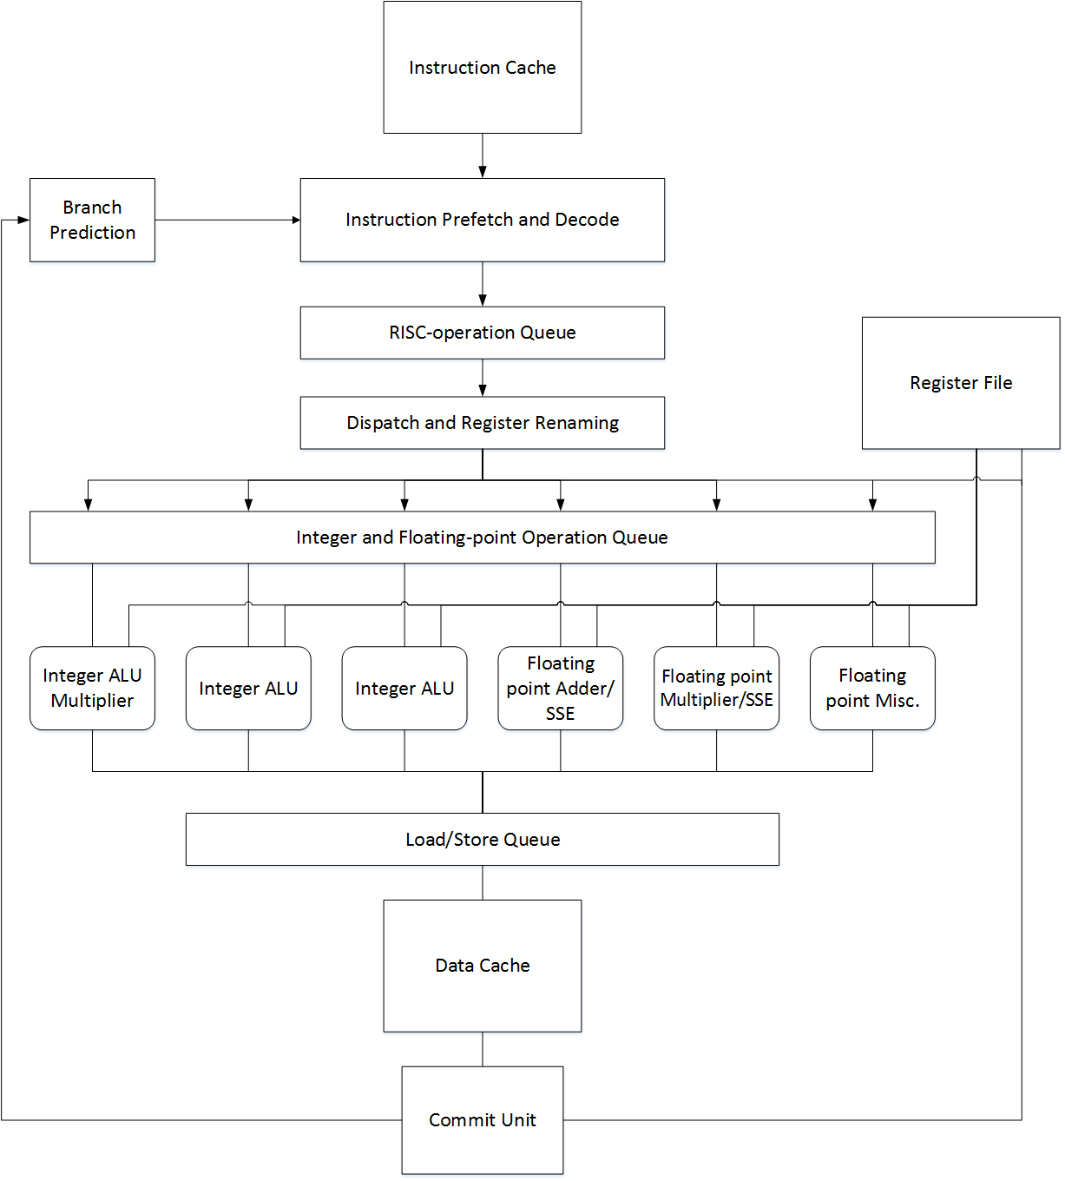
Modern Microprocessor Core
AMD Opteron

Slide 6
Asynchronous Circuits
Advantages:
No Clock
Low Power
Average Case Timing
Modular
Resistant to Environmental Effects
Natural Voltage Scaling
Low Electromagnetic Interference
Disadvantages:
Difficult to Design
Difficult to Test
Restricted Optimization
Minimal CAD Support

Slide 7
Asynchronous Circuit Design
Delay Insensitive Design
Often not possible
Quasi-Delay Insensitive Design
Isocronic forks – fanout assumed to arrive at all destinations simultaneously
Wire delays neglected
Asynchronous Latches
C-Element
X | Y | Out
0 | 0 | 0
0 | 1 | Out
1 | 0 | Out
1 | 1 | 1

Slide 8
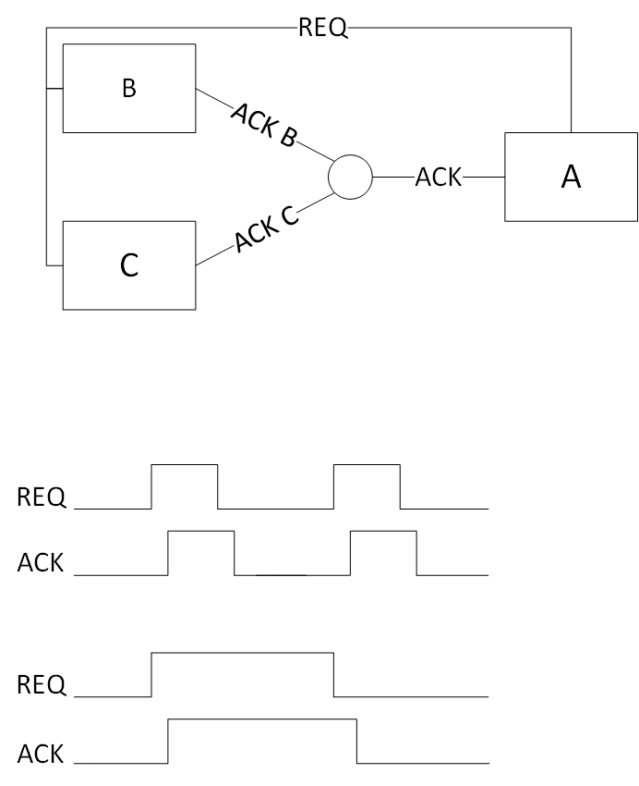
Asynchronous Communication
Request/Acknowledge protocol
Can send request to multiple components
C elements used to synchronize acknowledgements
Relies on self-timing to generate signals
4 phase
2 phase

Slide 9
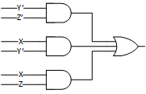
Glitch Free Design
X | Y | Z | Out
0 | 0 | 0 | 1
0 | 0 | 1 | 0
0 | 1 | 0 | 0
0 | 1 | 1 | 0
1 | 0 | 0 | 1
1 | 0 | 1 | 1
1 | 1 | 0 | 0
1 | 1 | 1 | 1
Minimized SOP has a potential glitch (XY’Z -> XY’Z’)
Glitch-free design based on prime implicants

Slide 10
Primary Benefits
Low Power
Perfect Clock Gating
Glitch-Free Design
No Clock Power
Minimized Idle Power
Automatic Voltage Scaling
High Throughput
Average Case Timing
Micropipelining
V | MIPS | mW | pJ/in | MIPS/W
1.8 1.1 0.9 0.8 0.5 | 200 100 66 48 4 | 10 20.7 9.2 4.4 0.170 | 500 207 139 92 43 | 1800 4830 7200 10900 23000
Caltech Lutonium with voltage Scaling

Slide 11
Design Difficulties
Fully delay insensitive design often impossible
Estimate delay of all gates
Requires glitch free design
Little optimization possible
Feedback loops are a core part of the design
No system level logic simulations
Micropipelines may require additional stages
Wire delays cannot be ignored in nanoscale design

Slide 12
Testing Difficulties
Feedback loops
Can use some tests where failure causes system to stall
Functional tests insufficient
Only up to 60% fault coverage without Design For Test (DFT) circuitry
Up to 50% additional area for 100% stuck-at coverage

Slide 13
Asynchronous Microprocessors
First CAM (Caltech Asynchronous Microprocessor), 1989
Others from Sun, Tokyo Institute of Technology, ARM, etc.
All showed similar trends
Low power
Resistant to environmental factors
Moderate throughput
Low testability

Slide 14
Asynchronous Microprocessors (cont.)
# | Processor | Word | Tech [/um] | Freq [/MHz] | Power per bit | Energy [/10⁻¹⁰ J] | Et² [10⁻²⁶ Js²]
1 2 | MiniMIPS (sim) MiniMIPS (fab) | 32 32 | 0.6 0.6 | 280 180 | 0.219 0.125 | 7.8 7 | 1.0 2.1
3 4 5 | R3000 (CPU) R3000A (CPU) VR3600 (CPU+FPU) | 32 32 32 | 1.2 1.0 0.8 | 25 33 40
6 7 8 9 10 | R4600 21064 R4400 SH7708 P6 | 64 64 64 16/32 32 | 0.64 0.6 0.6 0.5 0.6 | 150 20 150 60 150 | 0.0719 0.469 0.234 0.018 1.8 | 4.8 23.5 15.6 3 120 | 2.1 2.1 7.0 8.3 52
uP at 5.0V | Frequency (MHz) | MIPS | Power (mW) | MIPS/mW
AMULET 1a ARM 6 | - 20 | 12 18 | 150 150 | 0.08 0.12
uP at 3.0V | Frequency (MHz) | MIPS | Power (mW) | MIPS/mW
AMULET 2e ARM 710 ARM 710 ARM 810 | - 25 40 72 | 40 23 36 86 Drystone | 150 120 500 500 | 0.265 0.190 0.072 0.170
Amulet vs other ARM CPUs
Caltech MiniMIPS compared to similar CPUs

Slide 15
Elastic Circuits
Circuits with adaptive timing
Synchronous - inelastic
Delay insensitive - perfectly elastic

Slide 16
GALS (Globally Asynchronous, Locally Synchronous)
Multiple clock domains
Asynchronous request/acknowledge protocol
Uses:
System on Chip
Multicore Processors
Single core with multiple clock domains
Average throughput: 1 operation every 2 ns
Average throughput: 1 operation every 1 ns

Slide 17
Elastic Clock
Vary the width of each clock cycle
Each cycle matched to instruction
Current Uses
GALS
Frequency Scaling
Possible Uses:
Single Cycle CPU
Better Than Worst Case
Aperiodic Testing
Pipeline Voting
GALS with one input clock

Slide 18
Multi-Ring Oscillator
Initial idea – did not work

Slide 19
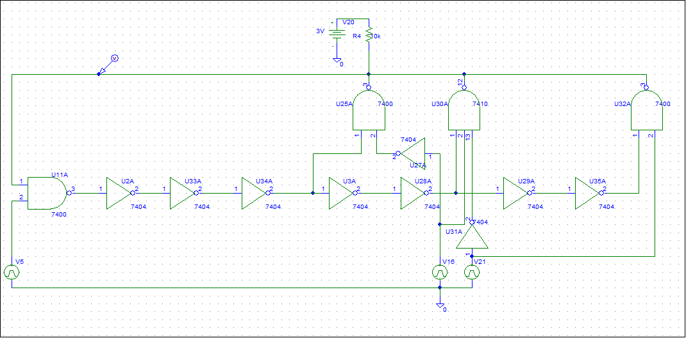
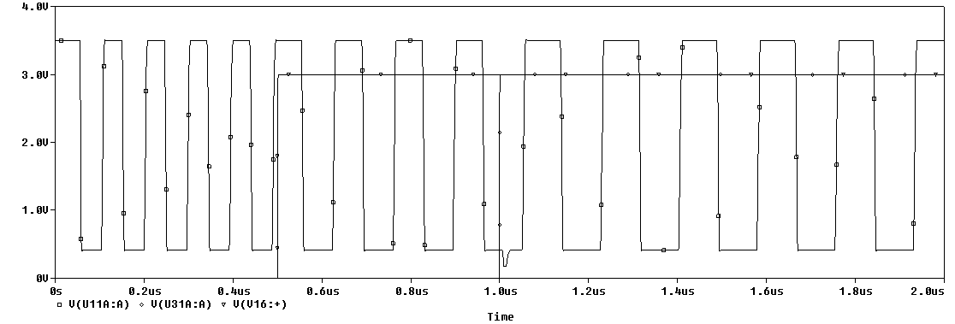
Multi-Ring Oscillator (cont.)

Slide 20
Pausable Ring Oscillator
Used in GALS
2 phase communication with 2 clocks
Equivalent to asynchronous circuit with artificial worst case paths
Very close to average case throughput
Simple to implement
Not delay insensitive

Slide 21
Counter
Counter increments on every input clock cycle
Each instruction has associated number
Can store each instruction number in reprogrammable memory
When the counter matches the number for the current instruction, the counter resets and the output is toggled
50% duty cycle, but very fast input clock
CLK_in
CLK_out
Inst.
RST

Slide 22
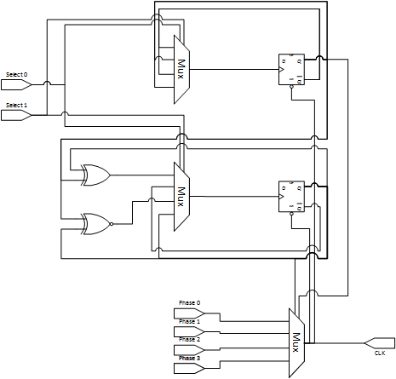
Multi-Phase Clock
Length of instruction used to select next phase line
Select flip-flops updated on falling edge of the output clock
Minimum clock = input clock
2 parts: Multiphase generator and selector

Slide 23
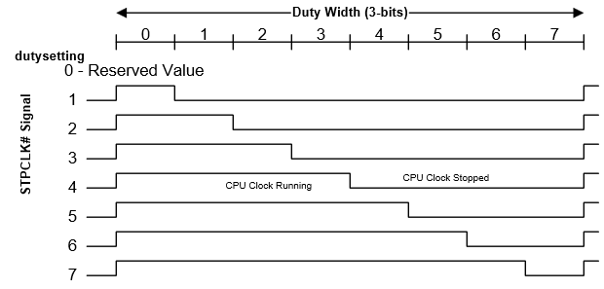
Stop Clock
Similar to clock throttling used in ACPI
Throttling turns off the clock for X cycles and on for N-X cycles
Stop output clock for X cycles and reset
Output is similar to multiphase clock – Uses less area
Slower input clock that Counter
Clock Throttling

Slide 24
CPU Test
Single Cycle Architecture
Calculate Fibonacci Sequence (0, 1, 1, 2, 3, 5, 8, 13, 21…) for 100 iterations
CPU optimized for area
Delay optimization improved worst case path by increasing other paths – overall performance loss with elastic clock
CPU uses low power transistors
Clock circuits use high speed transistors
Initialize | A = 0, B = 1, D = 0
Add | C = A + B
Store | A -> Mem
Add immediate | A <= B + 0
Load | B <- Mem
Add immediate | D + 1
Branch to end | if D = 100
Jump to Add
Jump to end | End

Slide 25
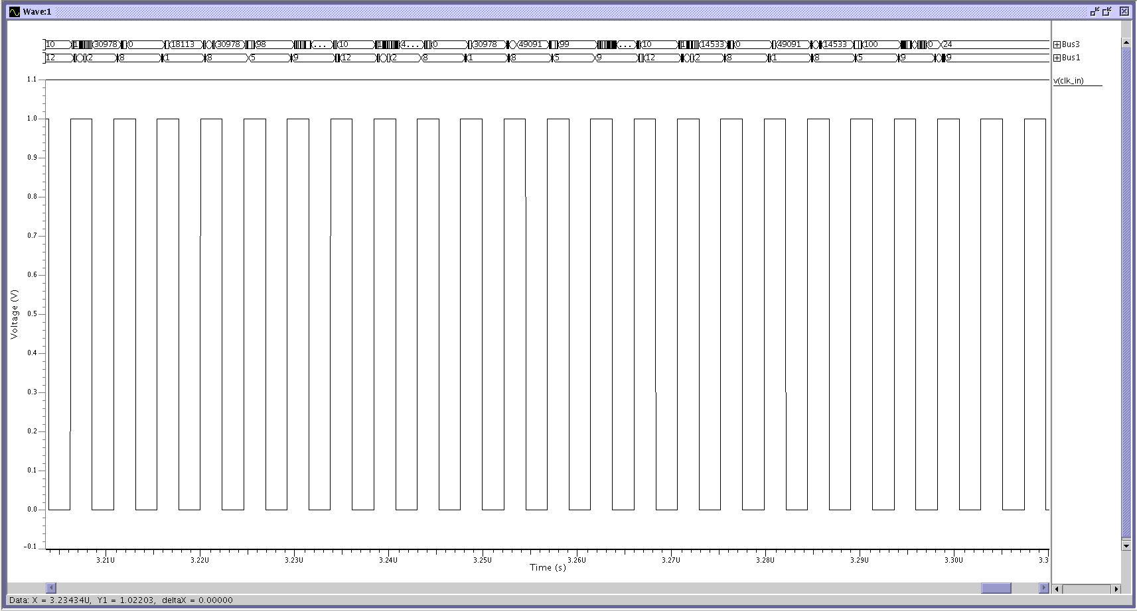
Initial Test

Slide 26
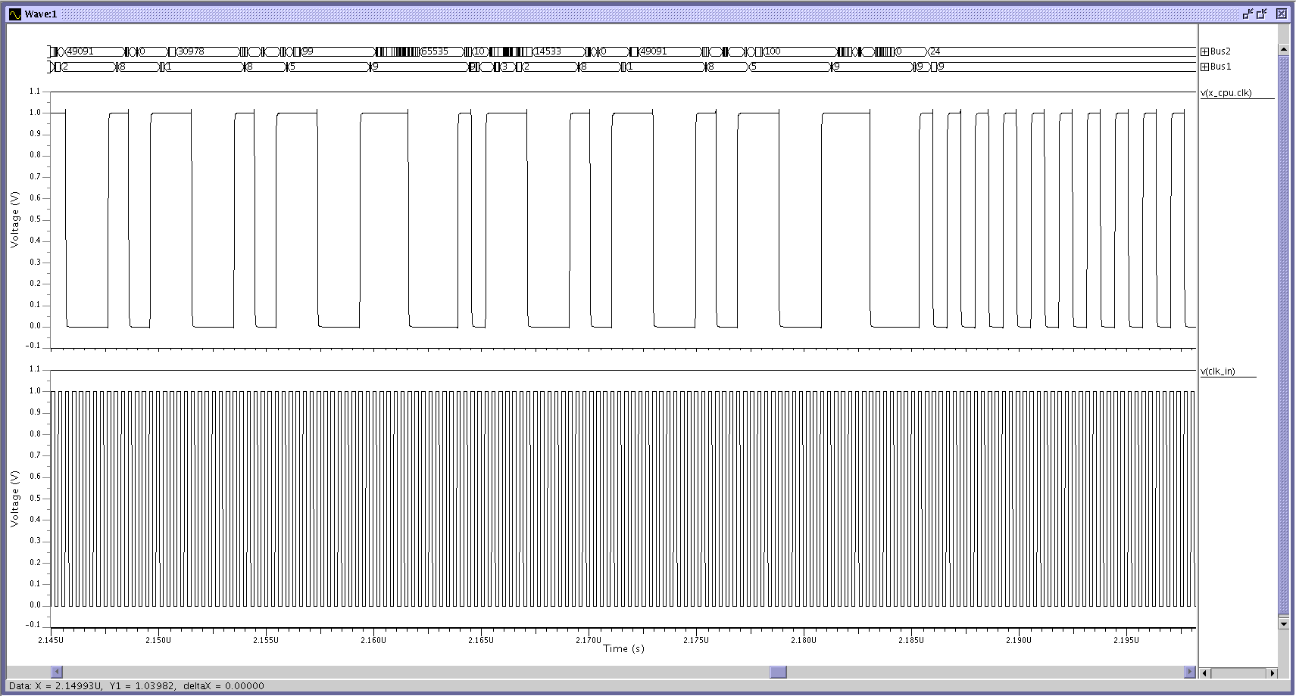
Counter Test

Slide 27
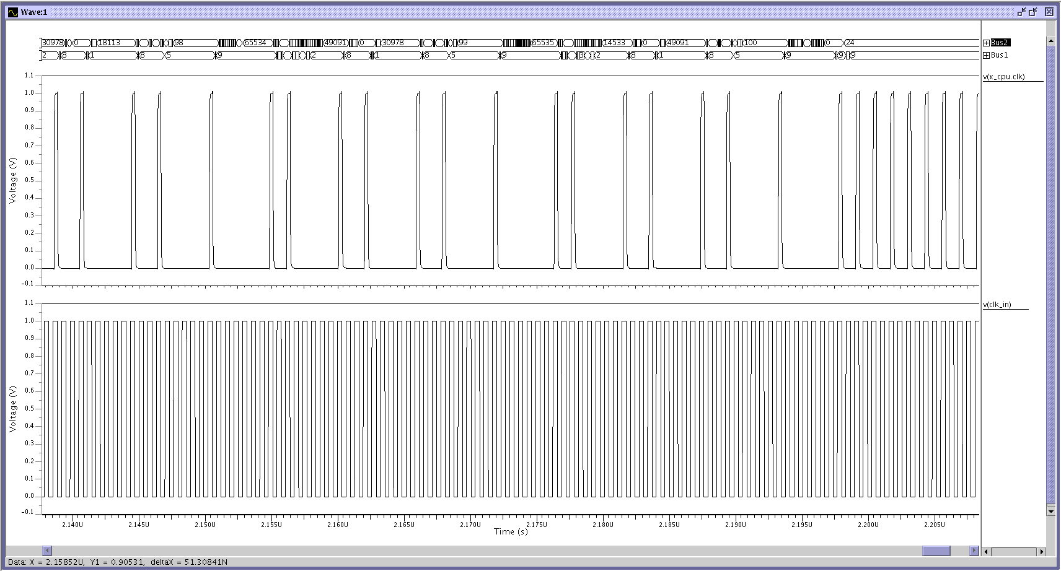
Multi-Phase Test

Slide 28
Power Results
Test | # Gates | Power (avg, mW) | Power (RMS, mW) | Test Time (µs) | Total Energy (nJ)
Synchronous | 2709 | 0.58885 | 0.5832 | 3.1648 | 1.8636
CPU + Elastic Clock | - | 0.79538 | 0.79745 | - | -
Compare | 51 | 0.16337 | 0.29986 | 2.0608 | 1.9758
Multiphase | 82 | 0.1290 | 0.26299 | 2.0608 | 1.905
Test times do not include setup
Multiphase uses ½ frequency of the comparator’s input clock
Energy is calculated as total avg power * time

Slide 29
Future Work
Create fully asynchronous cache model
Compare to pipeline implementation
Expand model to 32 bit architecture
Mix low power and high speed transistors in CPU
Improve clock control circuitry
Test various levels of optimization
Add Stop Clock method

Slide 30
Sources for Figures and Tables
Microprocessor Reference Guide, http://www.intel.com/pressroom/kits/quickreffam.htm (3)
Chris J. Myers, "Asynchronous Circuit Design", John Wiley & Sons, Inc., 2001 (5, 9)
Alain J. Martin, Mika Nystrm and Catherine G. Wong. "Three Generations of Asynchronous Microprocessors" in IEEE Design & Test of Computers, special issue on Clockless VLSI Design, November/December 2003 (10, 14)
Marc Belleville and Cyril Condemine "Energy Autonomous Micro and Nano Systems", John Wiley & Sons, Inc., 2012 (14)
J. Carmona, J. Cotadella, M. Kishinevsky and A. Taubin, "Elastic Circuits", in IEEE Transactions on Computer Aided Design of Integrated Circuits and Systems, Vol. 28, No. 10, October 2009 (15)
"Advanced Configuration and Power Interface Specification", Copyright 2014-2015 Unified EFI, inc. (23)

Slide 31
Questions?

